Slide 1





HOSPITAL MANAGEMENT SYSTEM
PROJECT BY:
SUJAL ANIL DUSANE
PRIYANKA BASAVARAJ BHADRAPPANAVAR
JOEVITA FAUSTINA DOSS FELIX ANTHONY RAJ
VINDHYA VASINI KAKU
YUNG-ROU KO

Slide 2



PROJECT OVERVIEW
To design and implement an efficient Hospital Appointment Management System that streamlines hospital operations, enhances patient satisfaction, and ensures secure handling of sensitive medical data.
PURPOSE
Traditional appointment management systems often lead to:
Double bookings
Long patient wait times
Administrative burdens
Delays in urgent care
This project addresses these issues by providing:
Optimized scheduling
Prioritization of emergency cases
Streamlined patient and doctor interactions
Automated notifications to reduce no-shows
Secure, role-based data access

Slide 3

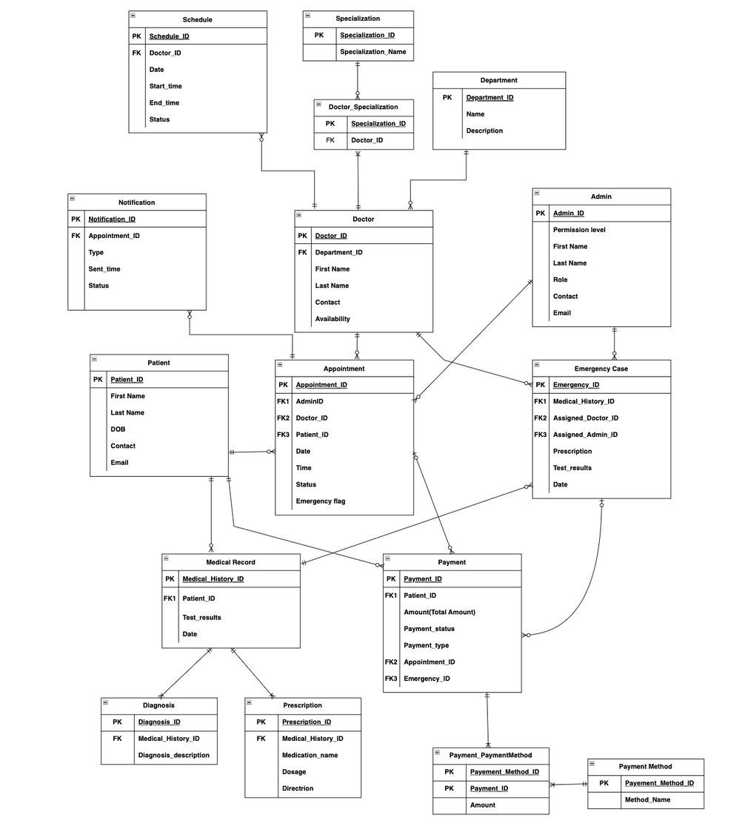
ENTITY RELATIONSHIP DIAGRAM (ERD)

Slide 4

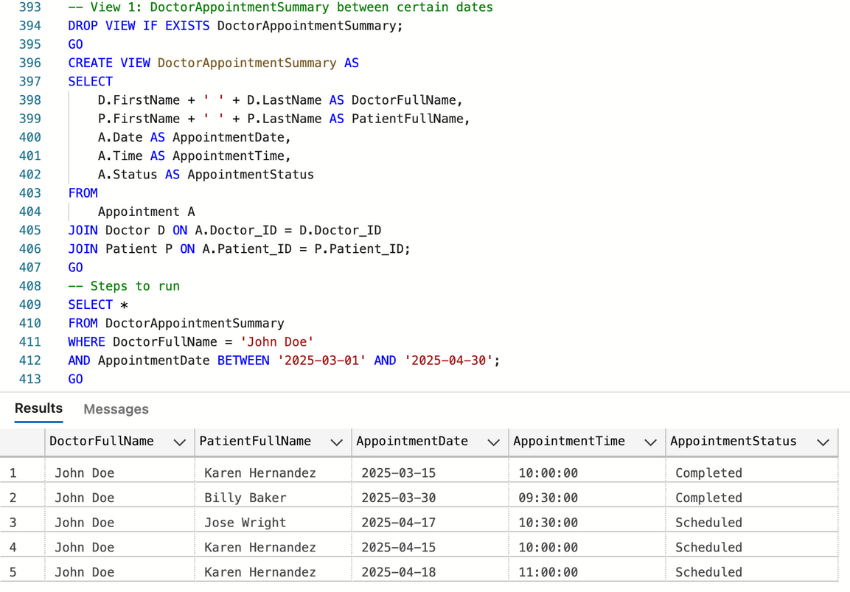
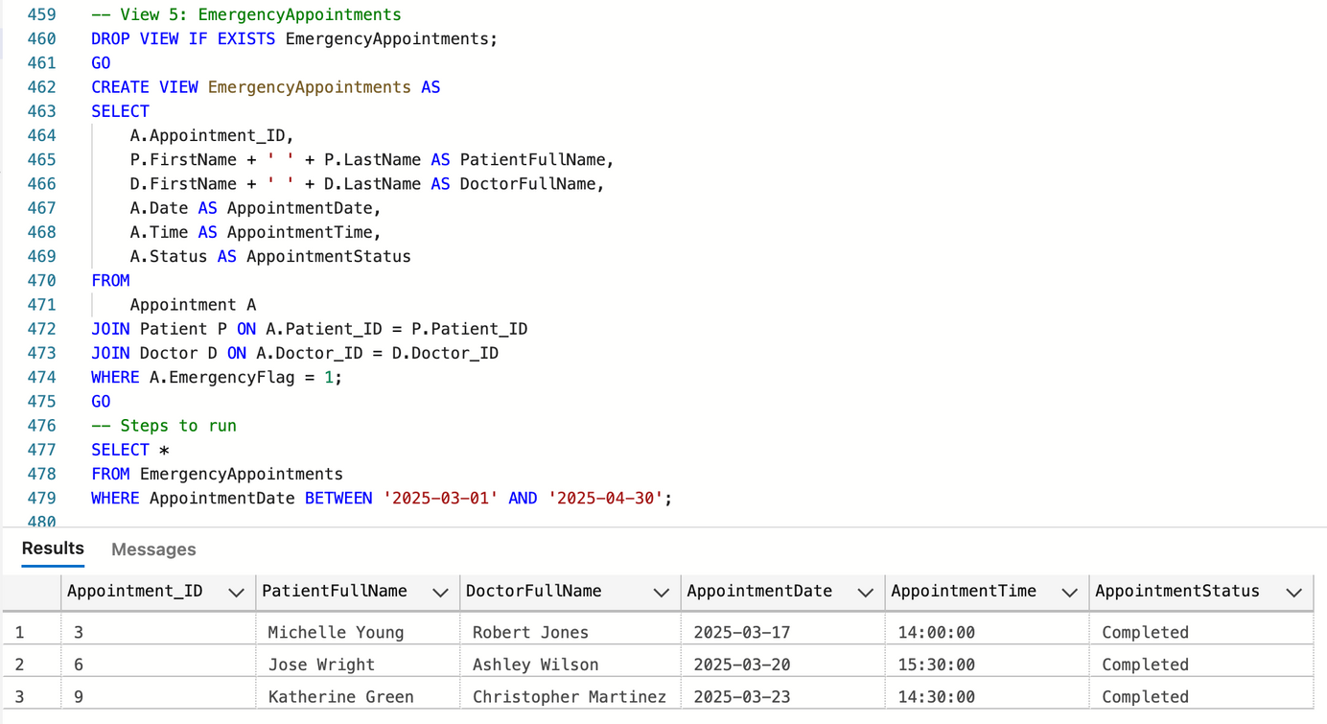
VIEWS
Lists all emergency appointments along with doctor and patient details — helps in identifying and managing urgent medical cases.
Displays appointments with patient names, date, time, and status for each doctor — useful for monitoring schedules and generating reports.

Slide 5
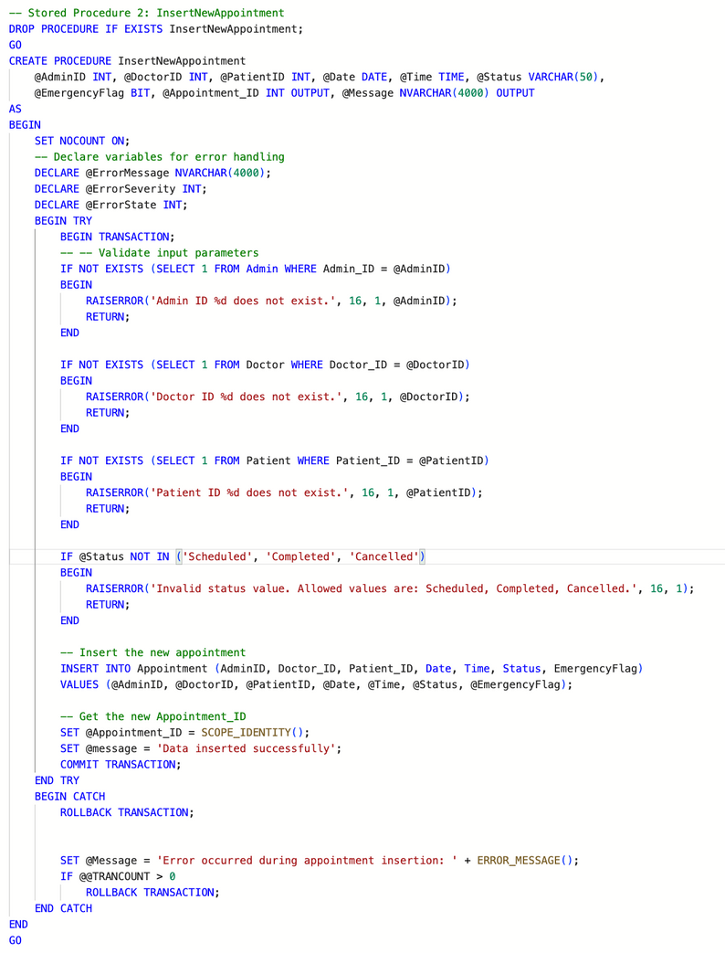
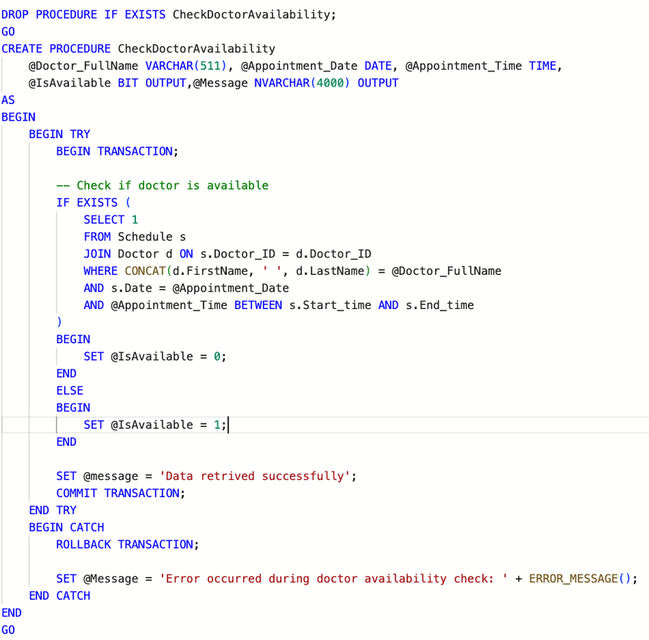


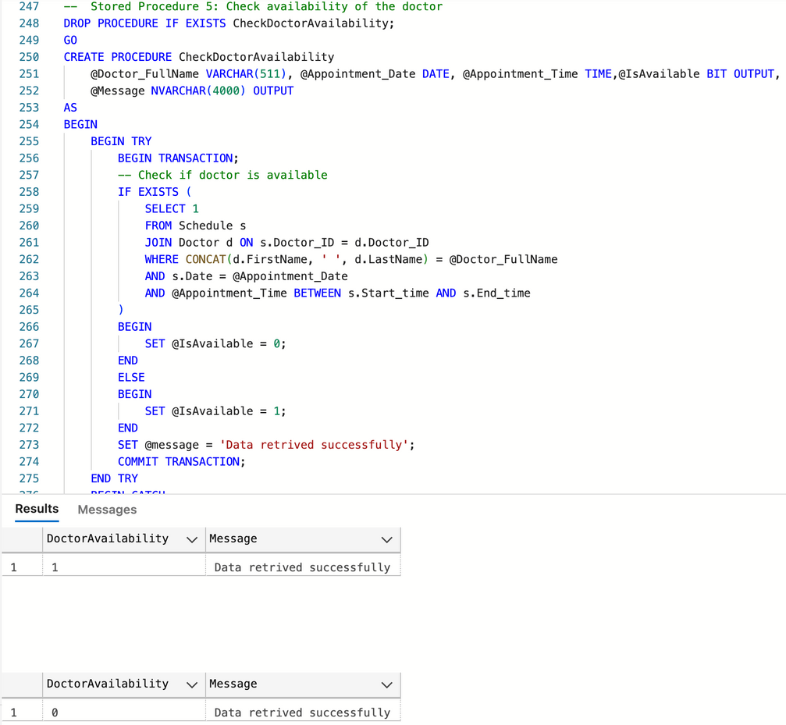
STORED PROCEDURES
Verifies if a doctor is free during a specific time slot by checking
their schedule — essential for conflict-free appointment booking.
Handles appointment creation with full input validation, error handling,
and transaction safety. Ensures only valid records are inserted.

Slide 6
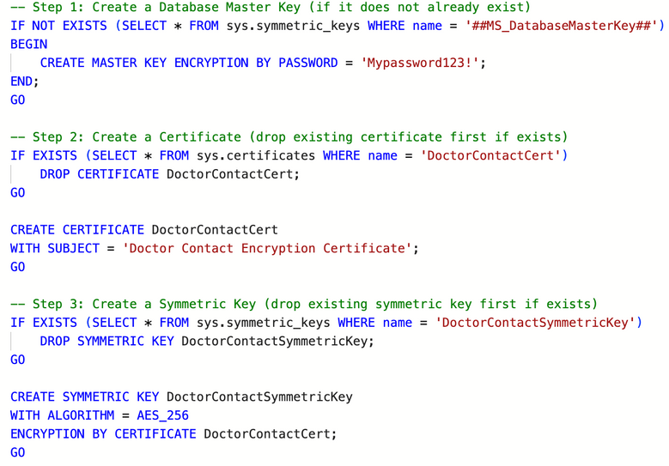
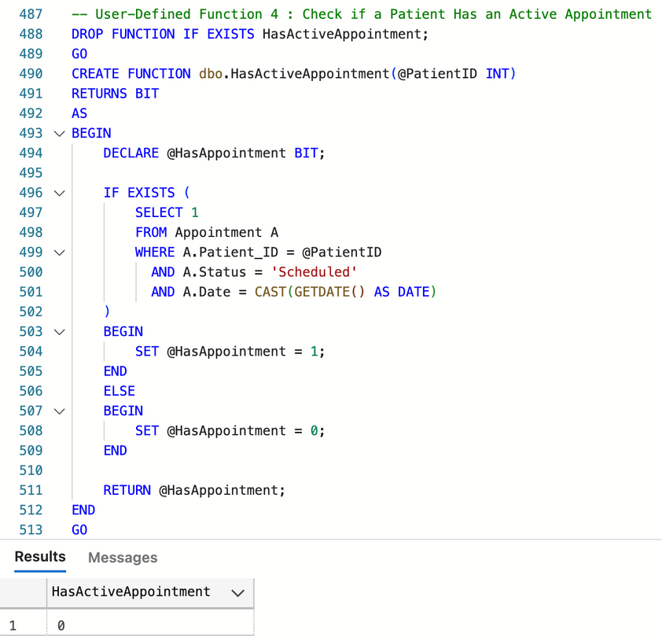
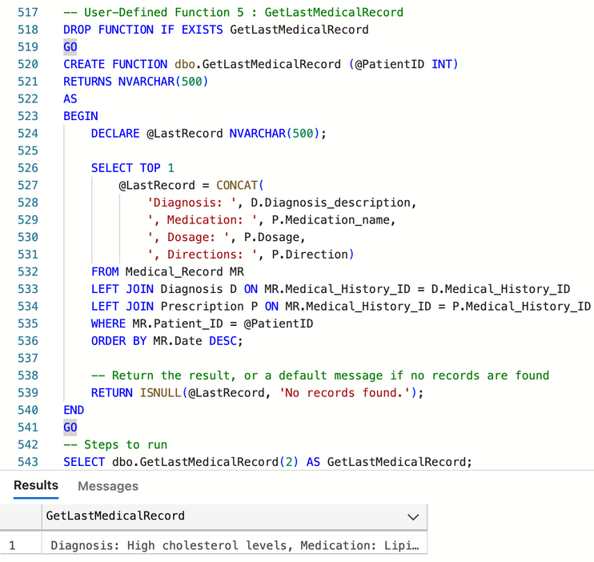
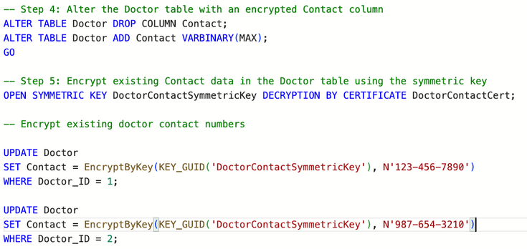
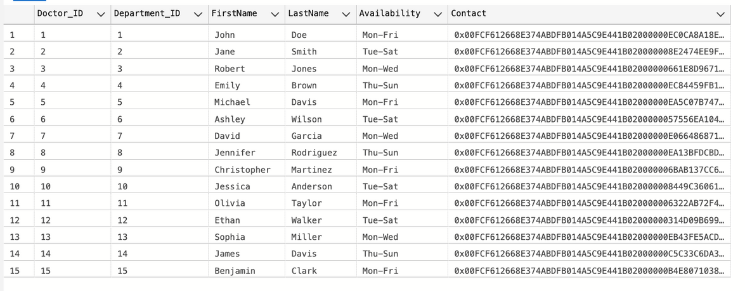
ENCRYPTION OF COLUMN
USER DEFINED FUNCTIONS
Output:

Slide 7


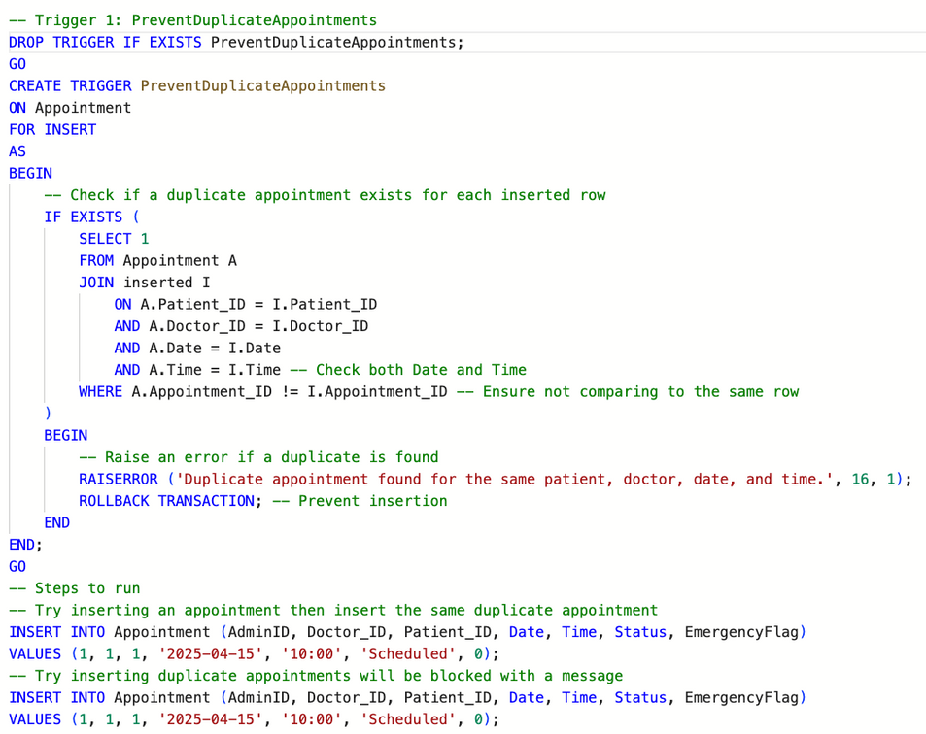
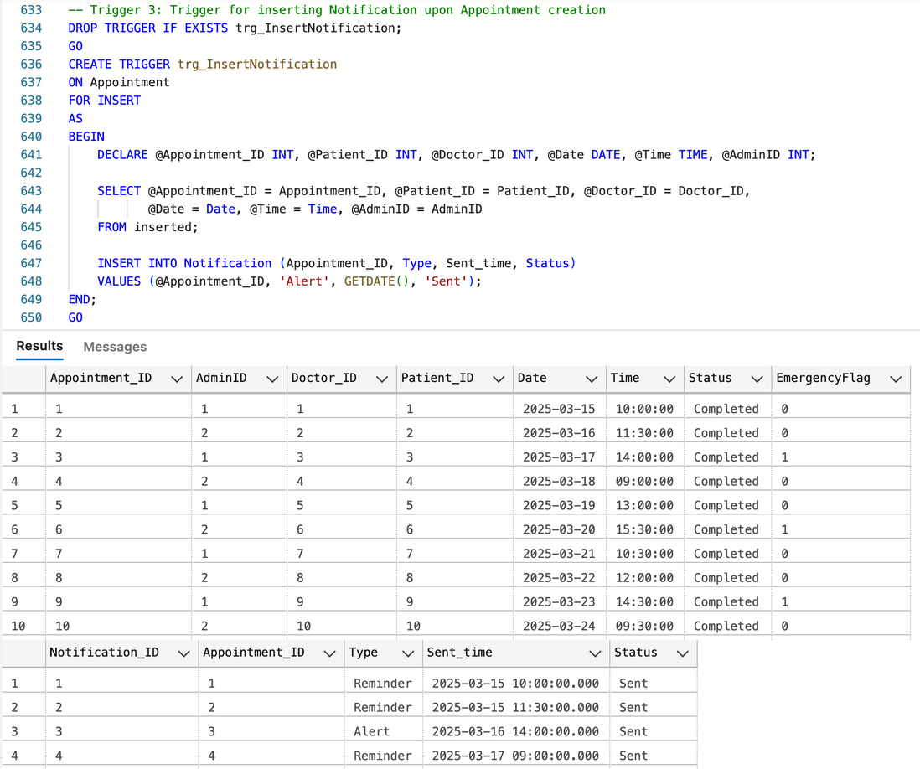
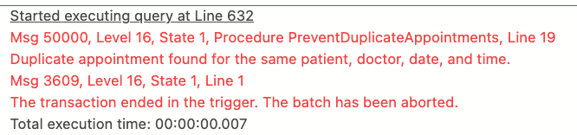
TRIGGERS
Automatically creates a notification record every time
a new appointment is added — enables real-time alerts.
Blocks duplicate appointments by checking if the same patient, doctor, date, and time already exist — ensures no double bookings.

Slide 8
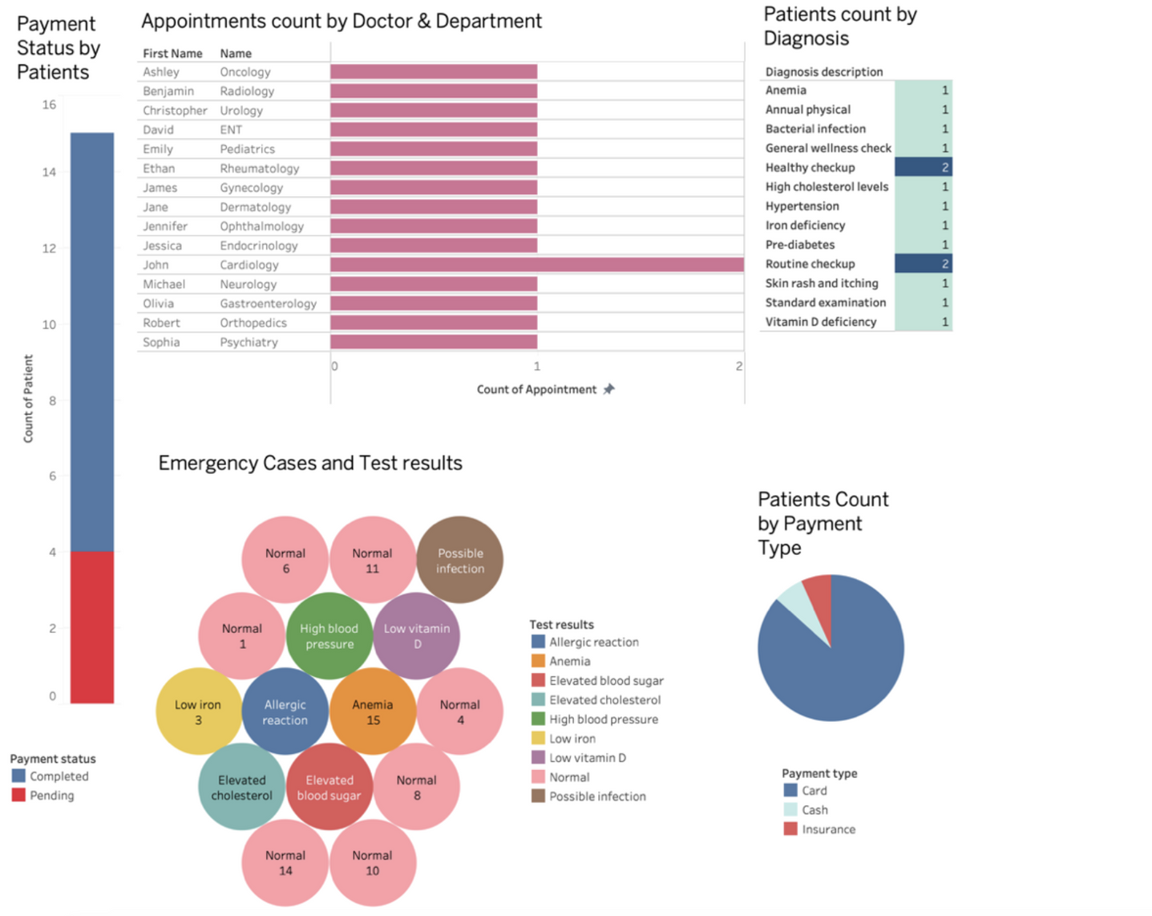


TABLEAU REPORT

Slide 9
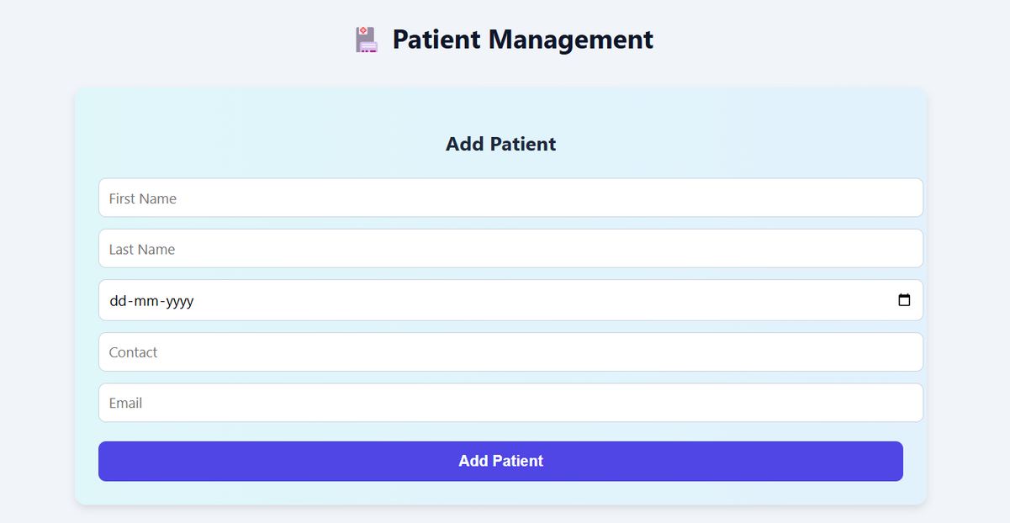
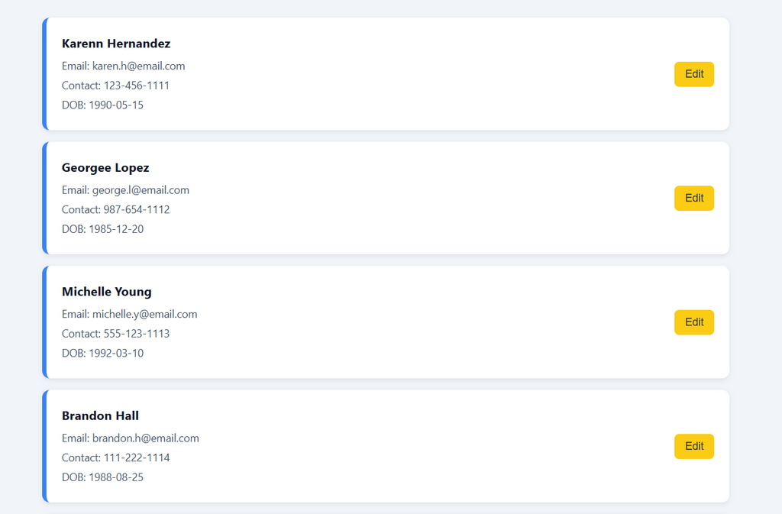
UI SCREENSHOTS

Slide 10
THANK YOU

